Slide 1
Juvenile rockfish ID guide for central CA kelp forests
Deep body
Elongate body
Dorsal spot
No spot
Dorsal spot
No spot
Elongate lower
jaw
= Bocaccio
White body,
dark mottling
= Canary
Red/black body,
clear caudal fin
= Vermilion
Dorsal
saddles
No dorsal
saddles
Dark triangle
= Stripetail
Faint white spots, body mostly brown
= Black
Vermiculated
red body
= Blue
Dark diamond
= Halfbanded
Brown bars on light body
(KGBC group)
Red rimmed
eyes
Dark body ‘Y’
= Calico
‘Y’ on 4th bar
= Kelp
Clear lateral line
= Copper
Dark saddles & white spots, yellow fins, mottled light body
= Olive or Yellowtail (OYT)
No ‘Y’, no clearing, but big enough to have these markings
= Gopher, Black & Yellow
= Grass or Brown
Unidentified YOY

Slide 2
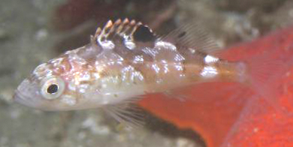
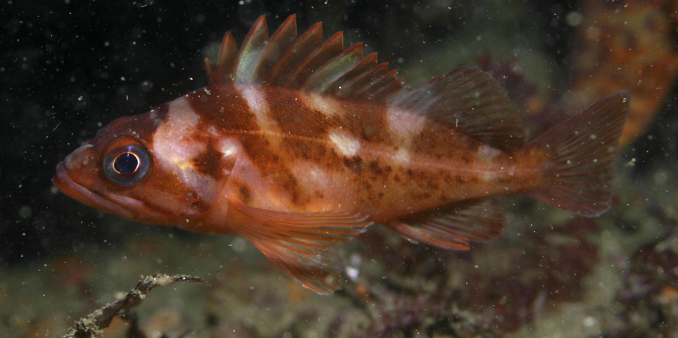
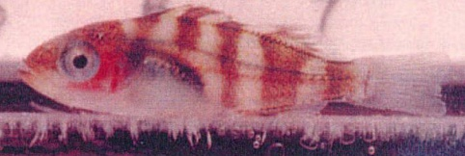
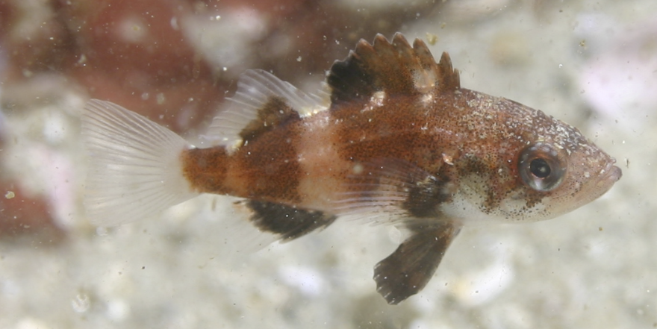
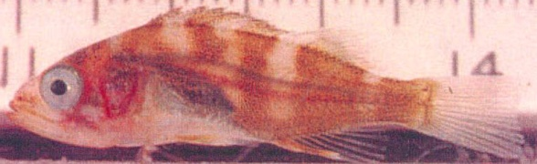
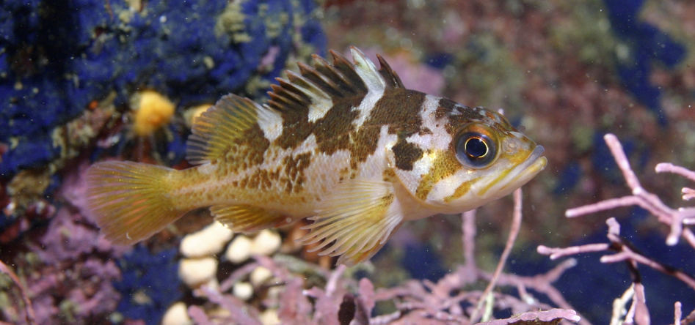
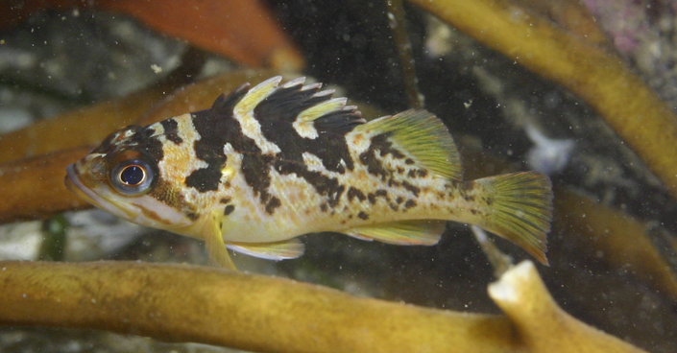
Juvenile rockfish ID guide for central CA kelp forests
Deep body YOY
Dorsal spot
No dorsal spot
Clearing on lateral line
= Copper
Big spot, white body with dark
mottling
= Canary
‘Y’ on 4th bar
= Kelp
No ‘Y’, no clearing, but big enough to have these markings
= Gopher, Black & Yellow
Gopher
Red/black body, clear caudal fin
= Vermilion
(Dorsal spot quickly fades w/growth)
Black & Yellow
MORE on next page

Slide 3
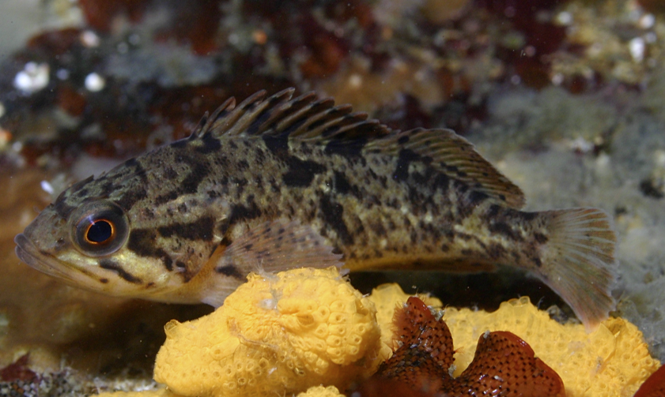
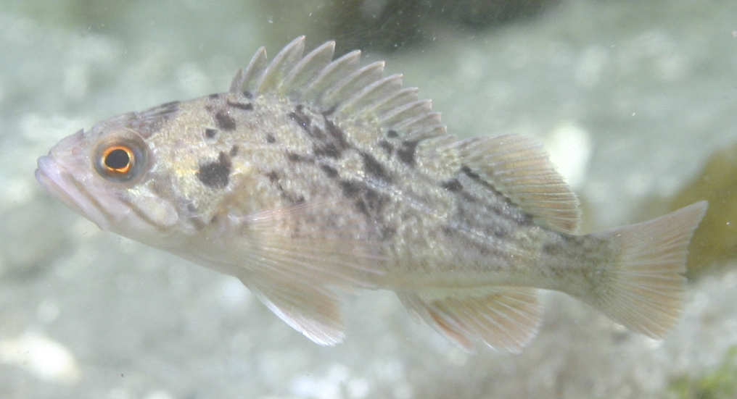
Juvenile rockfish ID guide for central CA kelp forests
Deep body YOY
No dorsal spot, Red eye
Dark, mottled, blunt head
= Grass
Light, mottled, big brown spot on operculum
= Brown

Slide 4
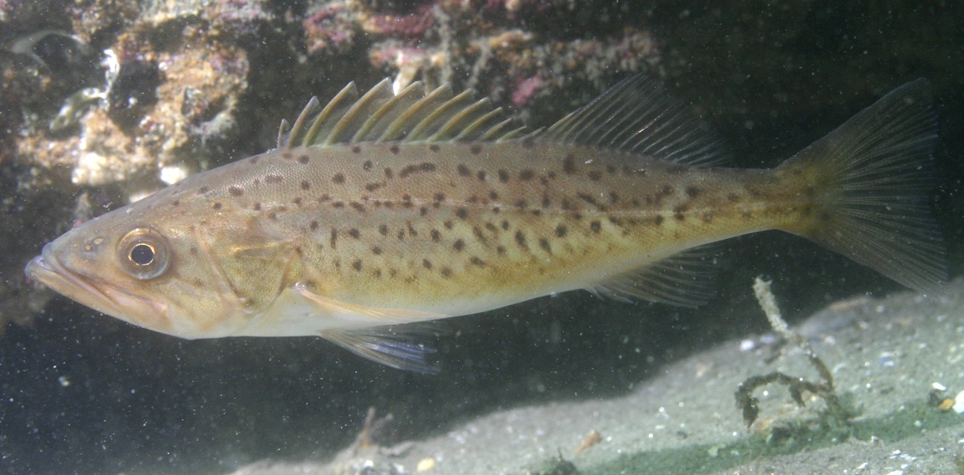
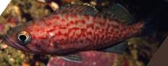
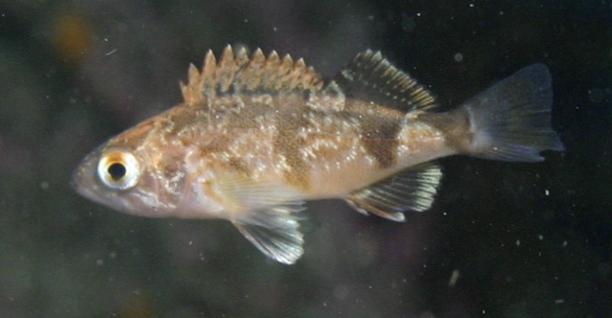
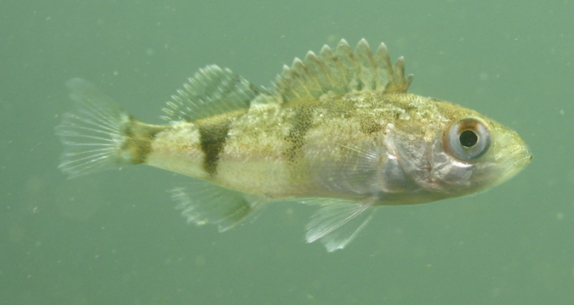
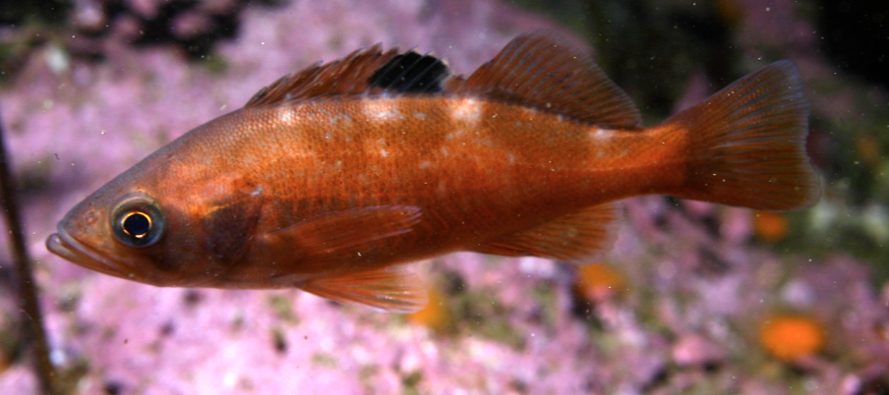
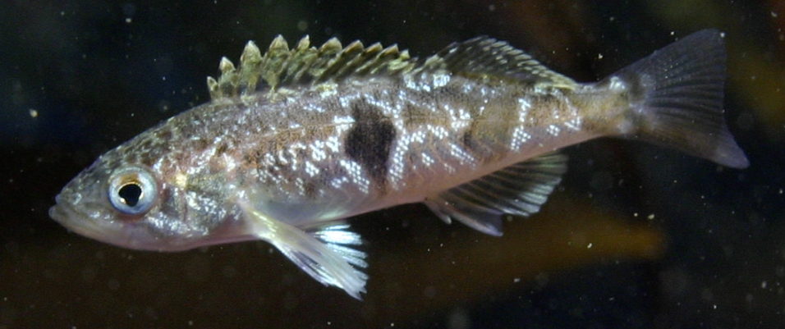
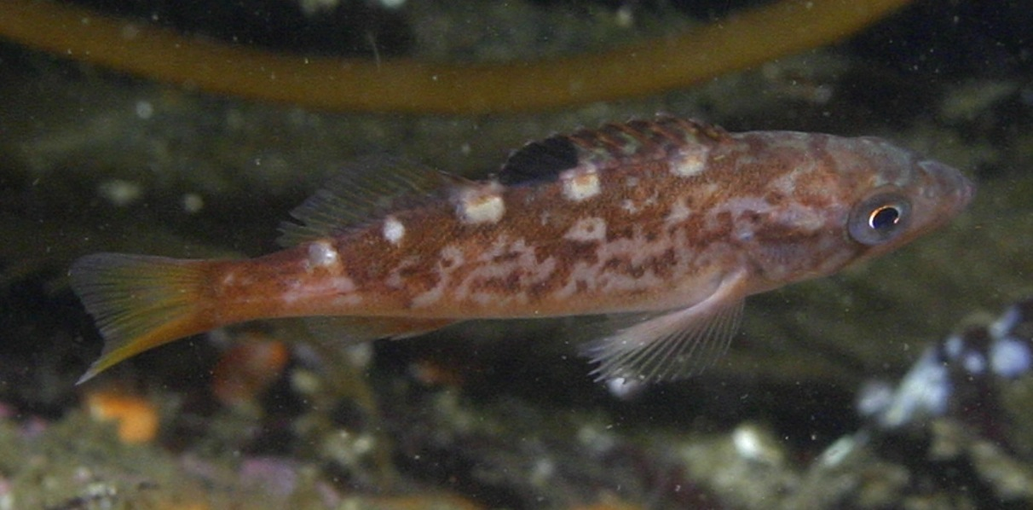
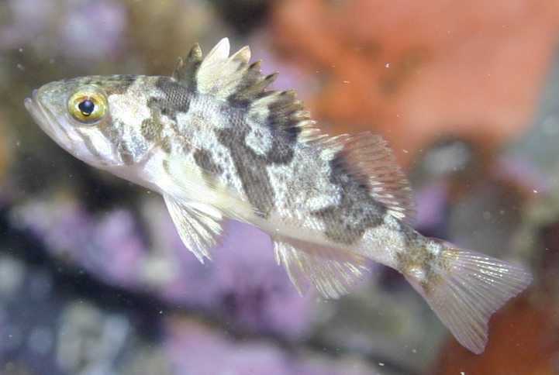
Juvenile rockfish ID guide for central CA kelp forests
Elongate body
Dorsal spot
No spot
Elongate lower jaw,
brown body spots
= Bocaccio
Vermiculated (wavy) red lines
= Blue
Dark triangle
under second dorsal fin
= Stripetail
Faint white dorsal spots, mostly a solid brown body (orange to black)
= Black
Dark diamond mid-body
= Halfbanded
Golden eye, dark ‘Y’ extending diagonally onto dorsal fin
= Calico
Bright white dorsal spots, yellow fins
= Olive or Yellowtail (aka OYT)

Slide 5
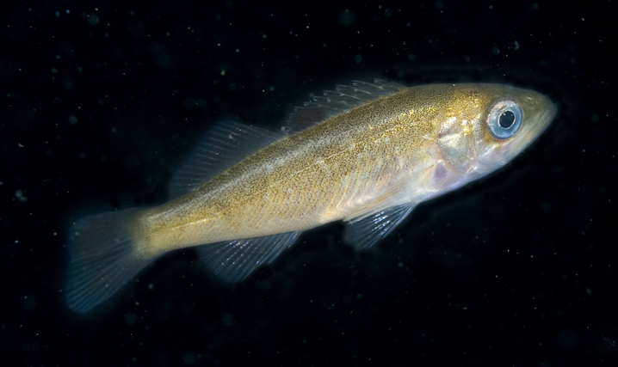
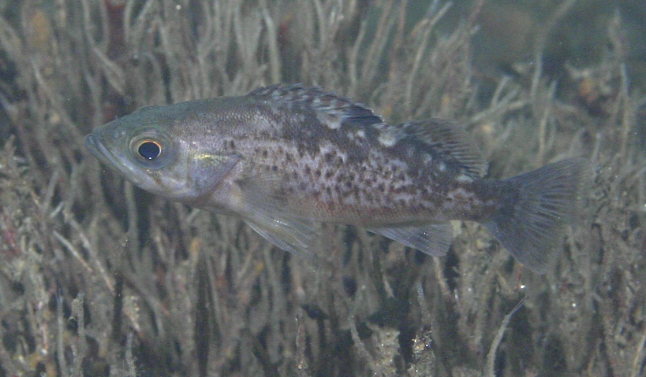
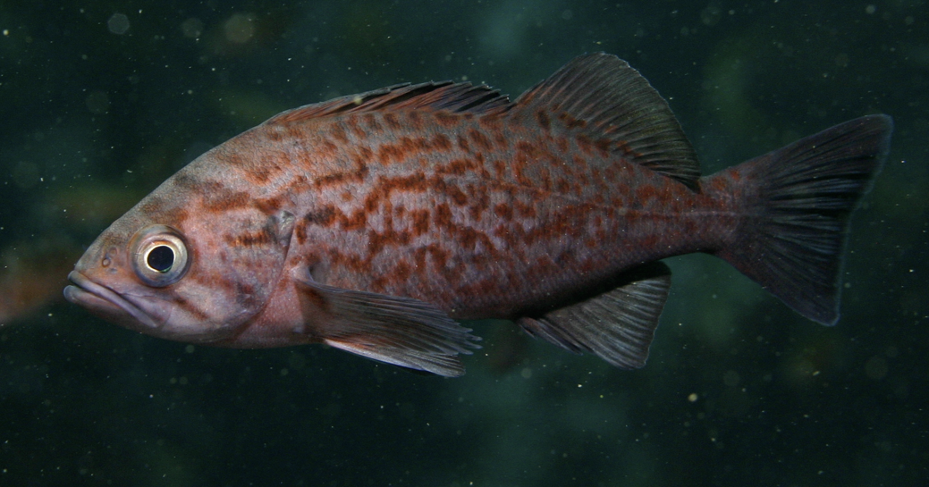
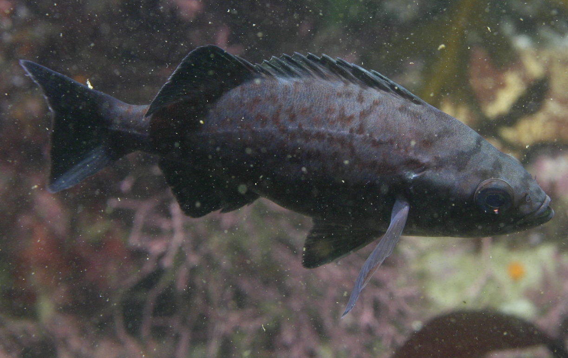
Juvenile rockfish ID guide for central CA kelp forests
Elongate body: YOY black vs. blue rockfish
Early in season
Late in season
Not vermiculated, mostly uniform golden-brown color, weak dorsal white patches, weak spot on dorsal fin
= Black
Early in season
Late in season
Vermiculated (wavy lines) red on blue when newly settled, very weak spot on dorsal fin
= Blue

Slide 6
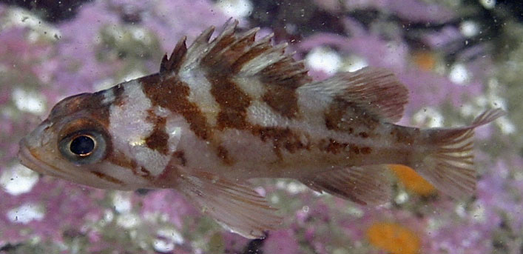
Typical YOY recruitment months (red). Note, this is when they settle out of plankton.
Jan | Feb | Mar | Apr | May | Jun | Jul | Aug | Sep | Oct | Nov | Dec
Vermilion
Copper
Canary
Blue

Slide 7
Typical YOY recruitment months (red). Note, this is when they settle out of plankton.
Jan | Feb | Mar | Apr | May | Jun | Jul | Aug | Sep | Oct | Nov | Dec
Black
OYT
Stripetail
Halfbanded

Slide 8
Typical YOY recruitment months (red). Note, this is when they settle out of plankton.
Jan | Feb | Mar | Apr | May | Jun | Jul | Aug | Sep | Oct | Nov | Dec
Grass
Brown
Calico

Slide 9
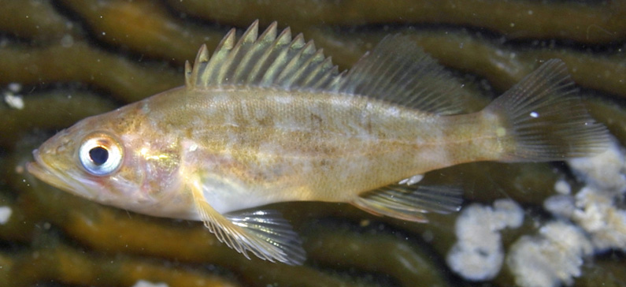
Typical YOY recruitment months (red). Note, this is when they settle out of plankton.
Jan | Feb | Mar | Apr | May | Jun | Jul | Aug | Sep | Oct | Nov | Dec
Bocaccio
Gopher
Black & Yellow
Kelp

